Slide 1
Lectures 9 & 10 & 11 Curve Fitting: Interpolation
CSE 2207
Numerical Methods

Slide 2
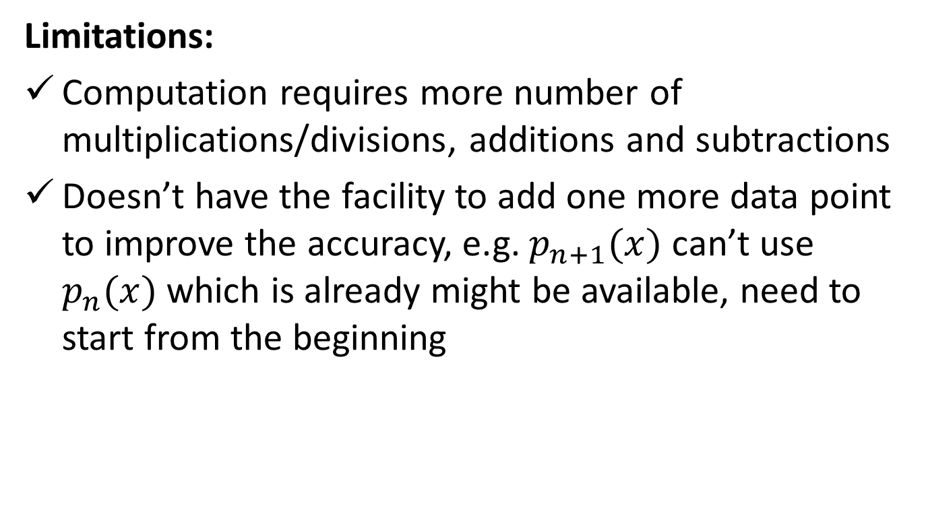
Lagrange Interpolation Polynomial
Limitations:
Computation requires more number of multiplications/divisions, additions and subtractions
Doesn’t have the facility to add one more data point to improve the accuracy, e.g. $p_{n+1}(x)$ can’t use $p_{n}(x)$ which is already might be available, need to start from the beginning

Slide 3
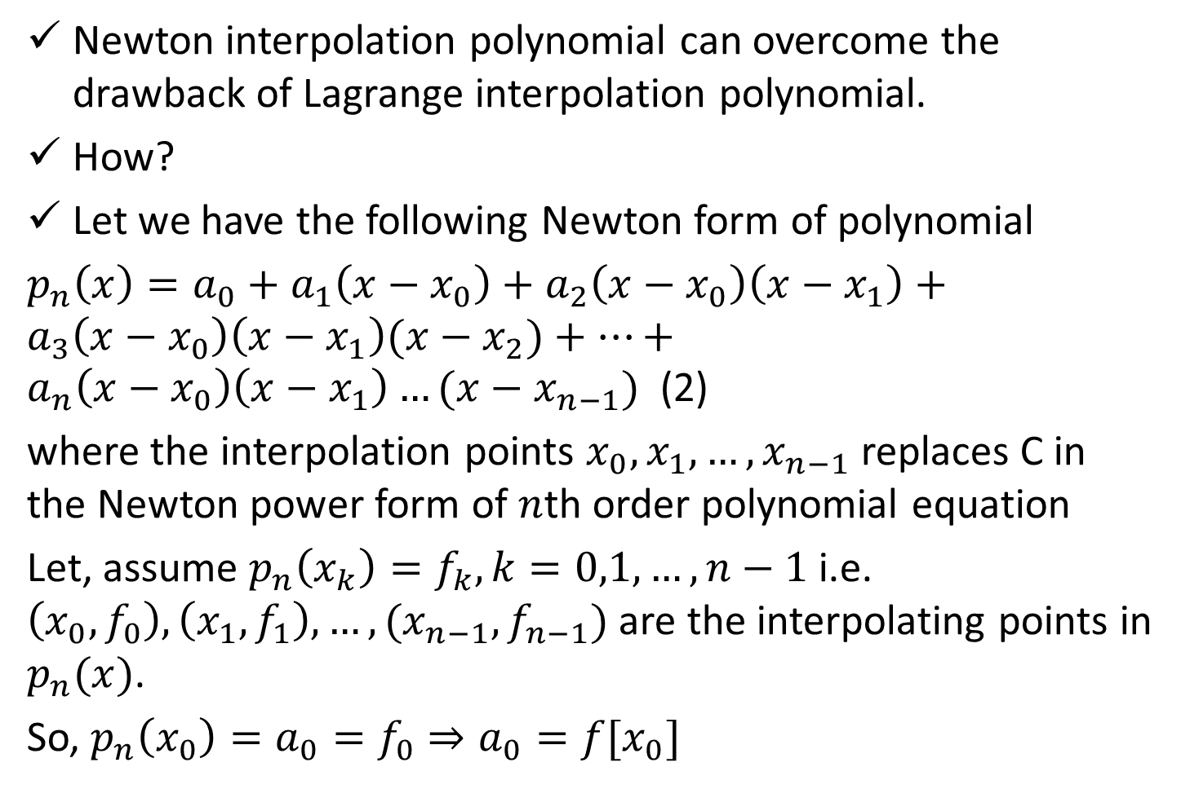
Newton Interpolation Polynomial
Newton interpolation polynomial can overcome the drawback of Lagrange interpolation polynomial.
How?
Let we have the following Newton form of polynomial
$p_{n}\left(x\right)=a_{0}+a_{1}\left(x−x_{0}\right)+a_{2}\left(x−x_{0}\right)\left(x−x_{1}\right)+a_{3}\left(x−x_{0}\right)\left(x−x_{1}\right)(x−x_{2})+…+a_{n}\left(x−x_{0}\right)\left(x−x_{1}\right)…(x−x_{n−1})$ (2)
where the interpolation points $x_{0},x_{1},…,x_{n−1}$ replaces C in the Newton power form of $n$th order polynomial equation
Let, assume $p_{n}\left(x_{k}\right)=f_{k}, k=0,1,…, n−1$i.e. $\left(x_{0},f_{0}\right),\left(x_{1},f_{1}\right),…,(x_{n−1},f_{n−1})$ are the interpolating points in $p_{n}(x)$.
So, $p_{n}\left(x_{0}\right)=a_{0}=f_{0}⇒a_{0}=f[x_{0}]$

Slide 4
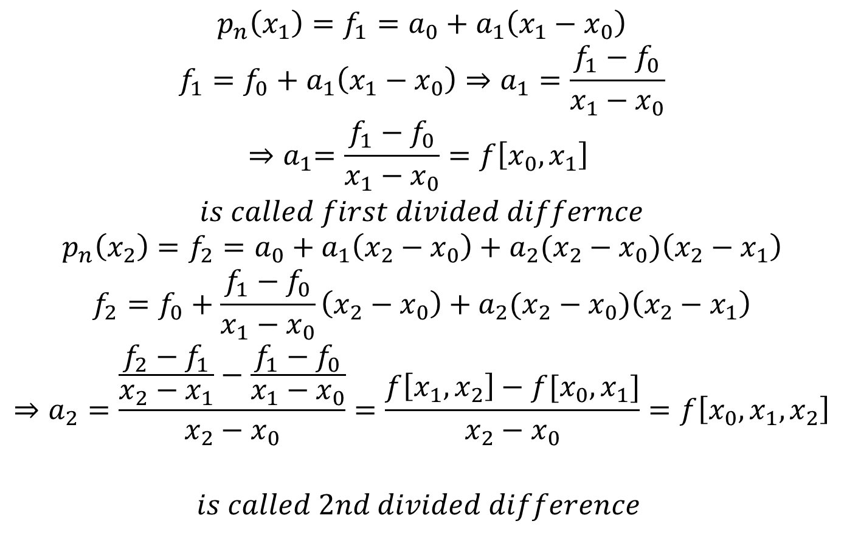
Newton Interpolation Polynomial (Cont.)
$$p_{n}\left(x_{1}\right)=f_{1}=a_{0}+a_{1}\left(x_{1}−x_{0}\right)$$
$$f_{1}=f_{0}+a_{1}\left(x_{1}−x_{0}\right)⇒a_{1}=\frac{f_{1}−f_{0}}{x_{1}−x_{0}}$$
$${⇒a}_{1}=\frac{f_{1}−f_{0}}{x_{1}−x_{0}}=f\left[x_{0},x_{1}\right]$$
$$is called first divided differnce$$
$$p_{n}\left(x_{2}\right)=f_{2}=a_{0}+a_{1}\left(x_{2}−x_{0}\right)+a_{2}(x_{2}−x_{0})\left(x_{2}−x_{1}\right)$$
$$f_{2}=f_{0}+\frac{f_{1}−f_{0}}{x_{1}−x_{0}}\left(x_{2}−x_{0}\right)+a_{2}(x_{2}−x_{0})\left(x_{2}−x_{1}\right)$$
$$⇒a_{2}=\frac{\frac{f_{2}−f_{1}}{x_{2}−x_{1}}−\frac{f_{1}−f_{0}}{x_{1}−x_{0}}}{x_{2}−x_{0}}=\frac{f\left[x_{1},x_{2}\right]−f[x_{0},x_{1}]}{x_{2}−x_{0}}=f\left[x_{0},x_{1},x_{2}\right]$$
$$is called 2nd divided difference$$

Slide 5
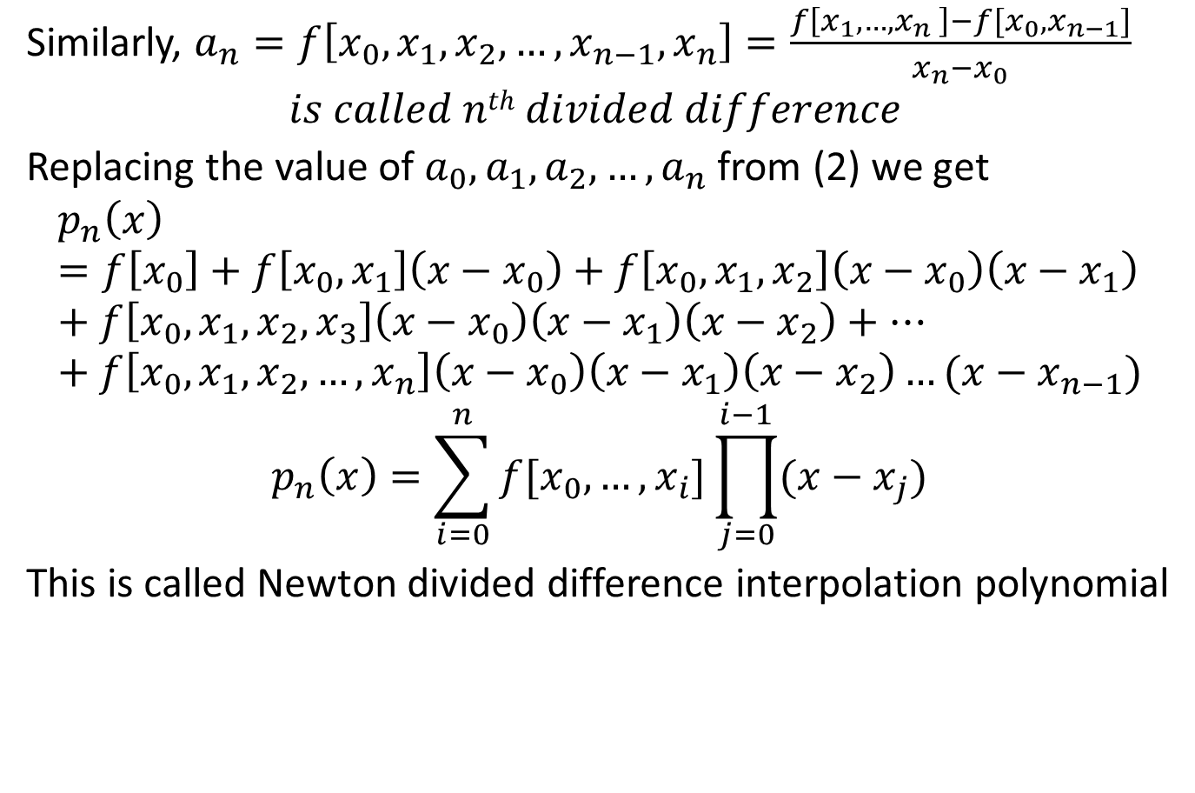
Newton Interpolation Polynomial (Cont.)
Similarly, $a_{n}=f\left[x_{0}, x_{1},x_{2},…,x_{n−1},x_{n}\right]=\frac{f\left[x_{1},{…,x}_{n}\right]−f[x_{0}, x_{n−1}]}{x_{n}−x_{0}}$
$$is called nth divided difference$$
Replacing the value of $a_{0}, a_{1}, a_{2}, …,a_{n}$ from (2) we get
$$p_{n}\left(x\right)=f\left[x_{0}\right]+f\left[x_{0},x_{1}\right]\left(x−x_{0}\right)+f\left[x_{0},x_{1},x_{2}\right]\left(x−x_{0}\right)\left(x−x_{1}\right)+f\left[x_{0},x_{1},x_{2},x_{3}\right]\left(x−x_{0}\right)\left(x−x_{1}\right)\left(x−x_{2}\right)+…+f\left[x_{0},x_{1},x_{2},…,x_{n}\right]\left(x−x_{0}\right)\left(x−x_{1}\right)\left(x−x_{2}\right)…(x−x_{n−1})$$
$$p_{n}\left(x\right)=\sum_{i=0}^{n}{f[x_{0},…,x_{i}]\prod_{j=0}^{i−1}{(x−x_{j})}}$$
This is called Newton divided difference interpolation polynomial
Forward diff.

Slide 6
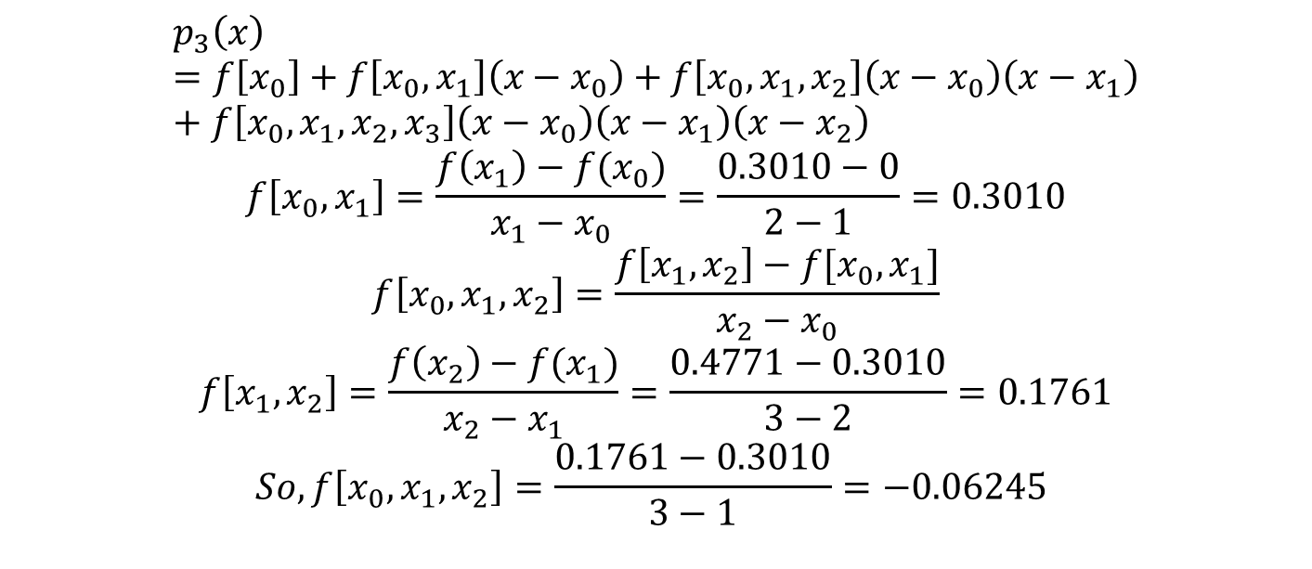

Newton Interpolation Polynomial (Cont.)
Lets try the following example using Newton interpolation polynomial to find $f(x) for x = 3.5$
i
0
1
2
3
$$x_{i}$$
𝑥_^{𝑖}
1
2
3
4
$$f(x_{i})$$
𝑓(𝑥_𝑖)
0
0.3010
0.4771
0.6021
$$p_{3}\left(x\right)=f\left[x_{0}\right]+f\left[x_{0},x_{1}\right]\left(x−x_{0}\right)+f\left[x_{0},x_{1},x_{2}\right]\left(x−x_{0}\right)\left(x−x_{1}\right)+f\left[x_{0},x_{1},x_{2},x_{3}\right]\left(x−x_{0}\right)\left(x−x_{1}\right)\left(x−x_{2}\right)$$
$$f\left[x_{0},x_{1}\right]=\frac{f\left(x_{1}\right)−f(x_{0})}{x_{1}−x_{0}}=\frac{0.3010−0}{2−1}=0.3010$$
$$f\left[x_{0},x_{1},x_{2}\right]=\frac{f\left[x_{1},x_{2}\right]−f[x_{0},x_{1}]}{x_{2}−x_{0}}$$
$$f\left[x_{1},x_{2}\right]=\frac{f\left(x_{2}\right)−f(x_{1})}{x_{2}−x_{1}}=\frac{0.4771−0.3010}{3−2}=0.1761$$
$$So,f\left[x_{0},x_{1},x_{2}\right]=\frac{0.1761−0.3010}{3−1}=−0.06245$$

Slide 7
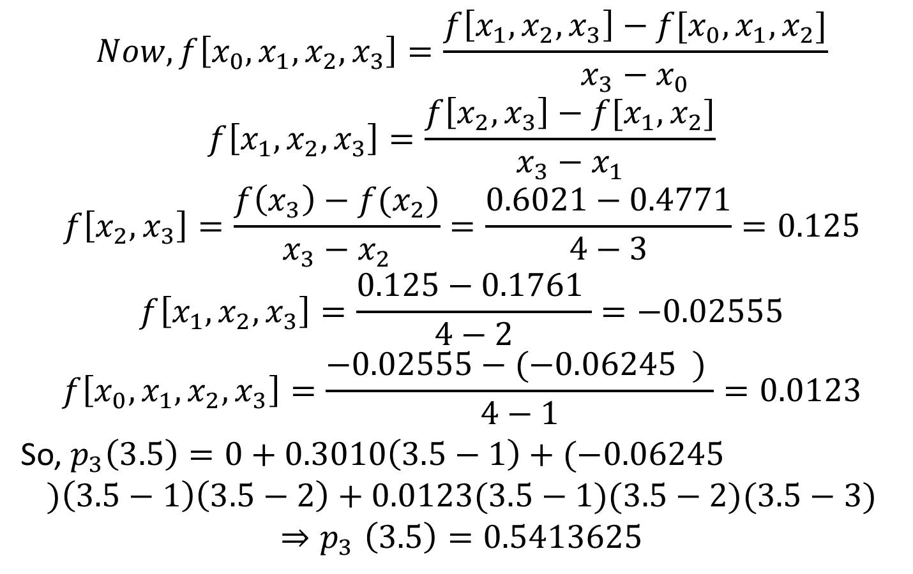
Newton Interpolation Polynomial (Cont.)
$$Now, f\left[x_{0},x_{1},x_{2},x_{3}\right]=\frac{f\left[x_{1},x_{2},x_{3}\right]−f[x_{0},x_{1},x_{2}]}{x_{3}−x_{0}}$$
$$f\left[x_{1},x_{2},x_{3}\right]=\frac{f\left[x_{2},x_{3}\right]−f[x_{1},x_{2}]}{x_{3}−x_{1}}$$
$$f\left[x_{2},x_{3}\right]=\frac{f\left(x_{3}\right)−f(x_{2})}{x_{3}−x_{2}}=\frac{0.6021−0.4771}{4−3}=0.125$$
$$f\left[x_{1},x_{2},x_{3}\right]=\frac{0.125−0.1761 }{4−2}=−0.02555$$
$$f\left[x_{0},x_{1},x_{2},x_{3}\right]=\frac{−0.02555−(−0.06245 ) }{4−1}=0.0123$$
So, $p_{3}\left(3.5\right)=0+0.3010\left(3.5−1\right)+(−0.06245$
$$)\left(3.5−1\right)\left(3.5−2\right)+0.0123(3.5−1)(3.5−2)(3.5−3)$$
$${⇒p}_{3}\left(3.5\right)=0.5413625$$
So, you see, we can add one more data points anytime for more accuracy in this method and also can reuse the previous calculation

Slide 8
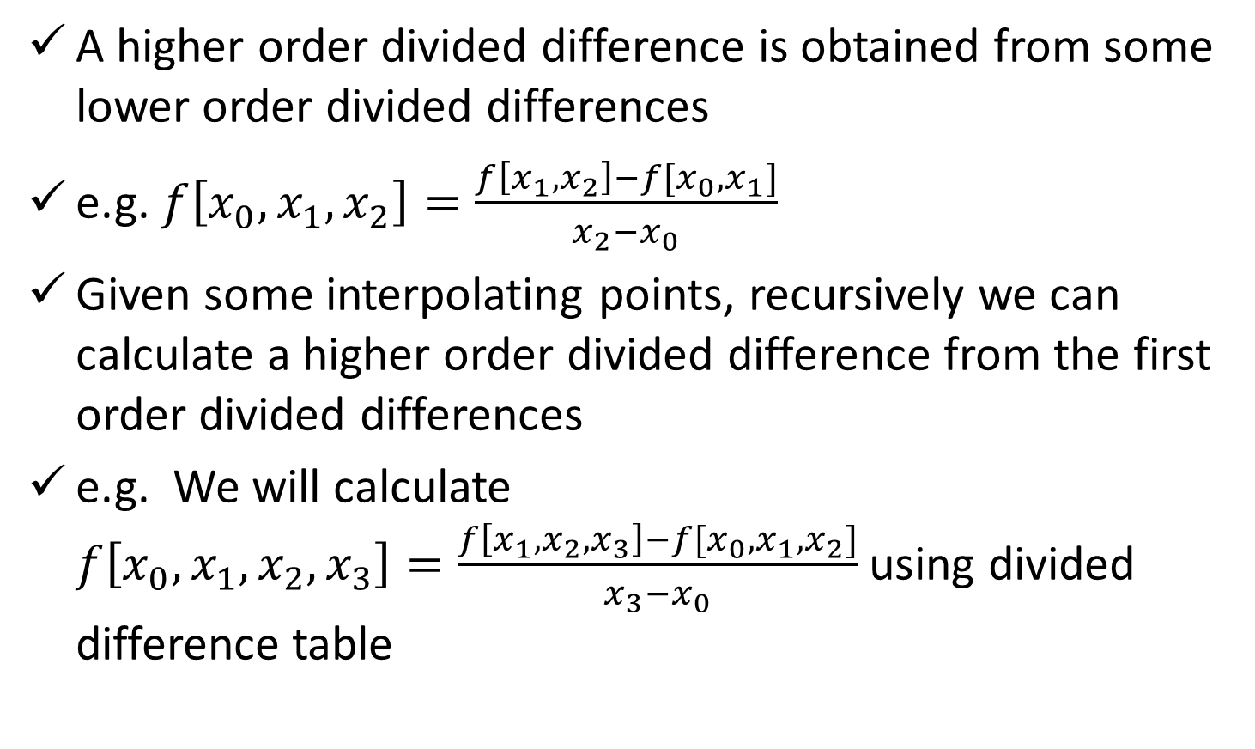
Divided Difference Table
A higher order divided difference is obtained from some lower order divided differences
e.g. $f\left[x_{0},x_{1},x_{2}\right]=\frac{f\left[x_{1},x_{2}\right]−f[x_{0},x_{1}]}{x_{2}−x_{0}}$
Given some interpolating points, recursively we can calculate a higher order divided difference from the first order divided differences
e.g. We will calculate $f\left[x_{0},x_{1},x_{2},x_{3}\right]=\frac{f\left[x_{1},x_{2},x_{3}\right]−f[x_{0},x_{1},x_{2}]}{x_{3}−x_{0}}$ using divided difference table

Slide 9

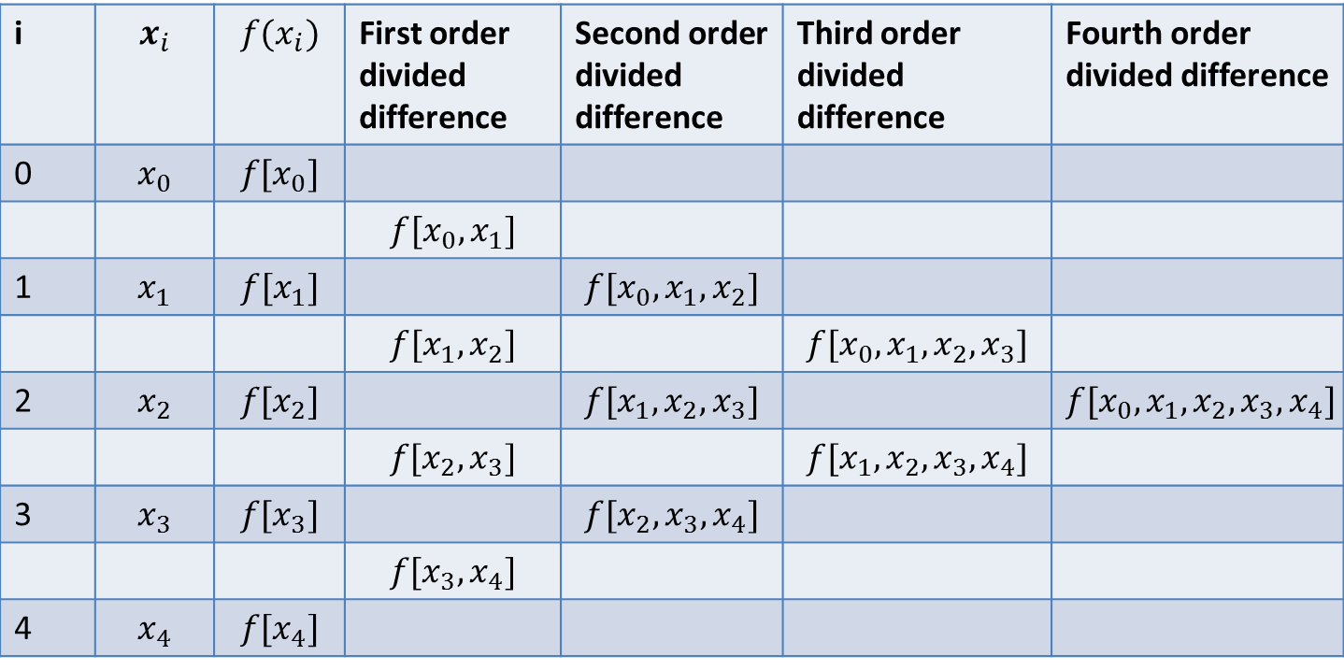




Divided Difference Table (Cont.)
i | $$x_{i}$$ | $$f(x_{i})$$ | First order divided difference | Second order divided difference | Third order divided difference | Fourth order divided difference
0 | $$x_{0}$$ | $$f[x_{0}]$$
 |  |  | $$f[x_{0},x_{1}]$$
1 | $$x_{1}$$ | $$f[x_{1}]$$ |  | $$f[x_{0},x_{1},x_{2}]$$
 |  |  | $$f[x_{1},x_{2}]$$ |  | $$f[x_{0},x_{1},x_{2},x_{3}]$$
2 | $$x_{2}$$ | $$f[x_{2}]$$ |  | $$f[x_{1},x_{2},x_{3}]$$ |  | $$f[x_{0},x_{1},x_{2},x_{3},x_{4}]$$
 |  |  | $$f[x_{2},x_{3}]$$ |  | $$f[x_{1},x_{2},x_{3},x_{4}]$$
3 | $$x_{3}$$ | $$f[x_{3}]$$ |  | $$f[x_{2},x_{3},x_{4}]$$
 |  |  | $$f[x_{3},x_{4}]$$
4 | $$x_{4}$$ | $$f[x_{4}]$$
$$a_{0}$$
$$a_{1}$$
$$a_{2}$$
$$a_{3}$$
$$a_{4}$$

Slide 10
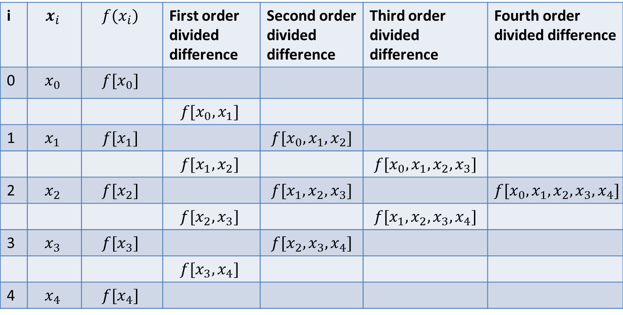
Divided Difference Table (Cont.)
i
0
1
2
3
$$x_{i}$$
𝑥_𝑖
1
2
3
4
5
$$f(x_{i})$$
𝑓(𝑥_𝑖)
0
63
7
26
124
⁴
Obtain the value of divided difference table for the given set of data points
i | $$x_{i}$$ | $$f(x_{i})$$ | First order divided difference | Second order divided difference | Third order divided difference | Fourth order divided difference
0 | $$x_{0}$$ | $$f[x_{0}]$$
 |  |  | $$f[x_{0},x_{1}]$$
1 | $$x_{1}$$ | $$f[x_{1}]$$ |  | $$f[x_{0},x_{1},x_{2}]$$
 |  |  | $$f[x_{1},x_{2}]$$ |  | $$f[x_{0},x_{1},x_{2},x_{3}]$$
2 | $$x_{2}$$ | $$f[x_{2}]$$ |  | $$f[x_{1},x_{2},x_{3}]$$ |  | $$f[x_{0},x_{1},x_{2},x_{3},x_{4}]$$
 |  |  | $$f[x_{2},x_{3}]$$ |  | $$f[x_{1},x_{2},x_{3},x_{4}]$$
3 | $$x_{3}$$ | $$f[x_{3}]$$ |  | $$f[x_{2},x_{3},x_{4}]$$
 |  |  | $$f[x_{3},x_{4}]$$
4 | $$x_{4}$$ | $$f[x_{4}]$$
=1
=0
=7
=6
=2
=7
=1
=19
=9
=0
=3
=26
=1
=37
=12
=4
=63
=61
=5
=124

Slide 11

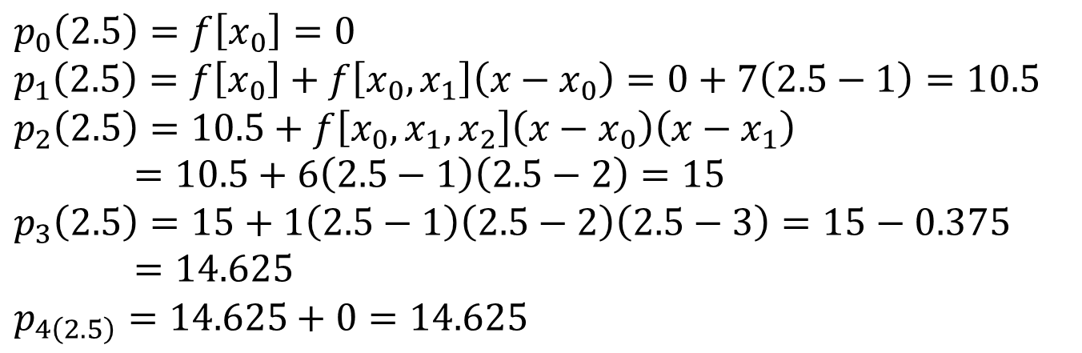
Divided Difference Table (Cont.)
Now calculate $f(2.5)$ using the previous divided difference table
$$p_{0}\left(2.5\right)=f\left[x_{0}\right]=0$$
$$p_{1}\left(2.5\right)=f\left[x_{0}\right]+f\left[x_{0},x_{1}\right]\left(x−x_{0}\right)=0+7\left(2.5−1\right)=10.5$$
$$p_{2}\left(2.5\right)=10.5+f\left[x_{0},x_{1},x_{2}\right]\left(x−x_{0}\right)\left(x−x_{1}\right)=10.5+6\left(2.5−1\right)\left(2.5−2\right)=15$$
$$p_{3}\left(2.5\right)=15+1\left(2.5−1\right)\left(2.5−2\right)\left(2.5−3\right)=15−0.375=14.625$$
$$p_{4\left(2.5\right)}=14.625+0=14.625$$
The example function is a 3rd order polynomial function. Because its 4th order derivative is zero

Slide 12
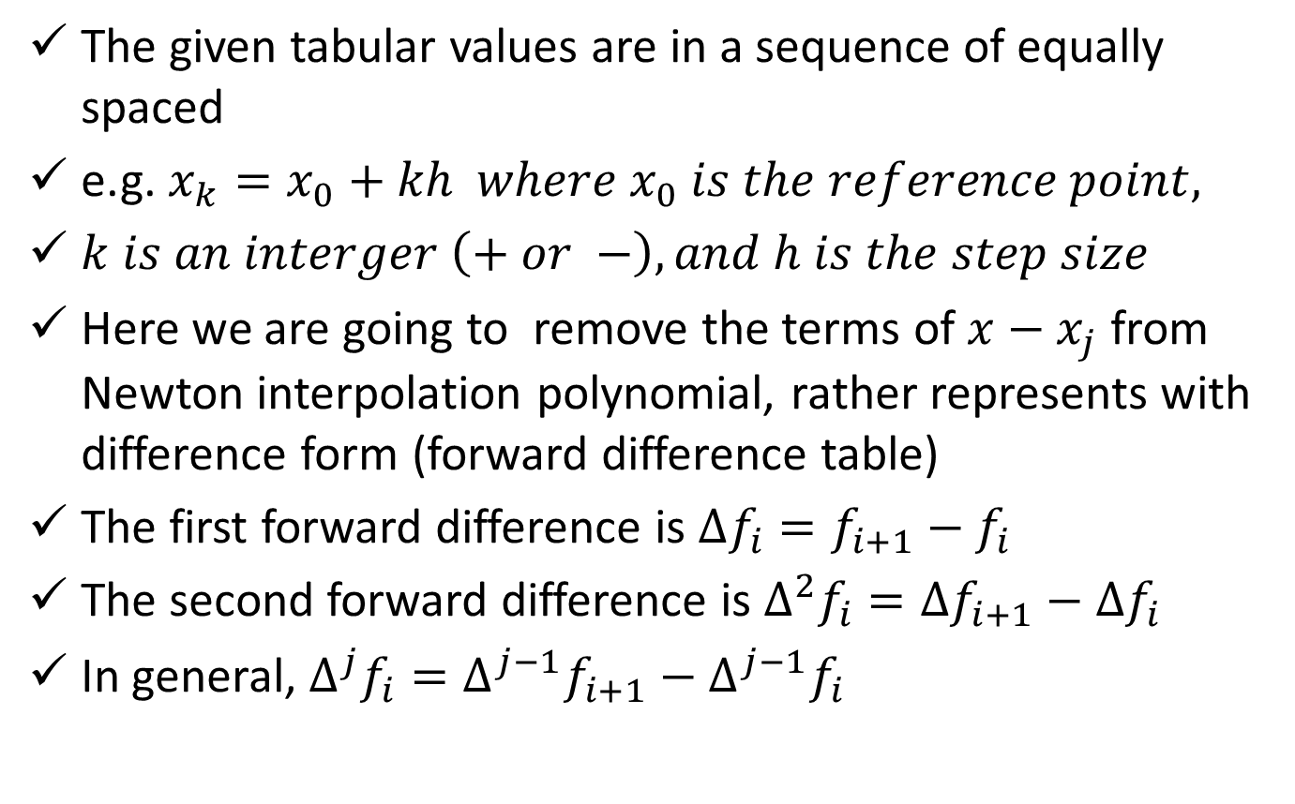
Interpolation with Equidistant Points
The given tabular values are in a sequence of equally spaced
e.g. $x_{k}=x_{0}+kh where x_{0} is the reference point,$
$k is an interger \left(+ or −\right), and h is the step size$
Here we are going to remove the terms of $x−x_{j}$ from Newton interpolation polynomial, rather represents with difference form (forward difference table)
The first forward difference is $∆f_{i}=f_{i+1}−f_{i}$
The second forward difference is $∆^{2}f_{i}=∆f_{i+1}−∆f_{i}$
In general, $∆^{j}f_{i}=∆^{j−1}f_{i+1}−∆^{j−1}f_{i}$

Slide 13
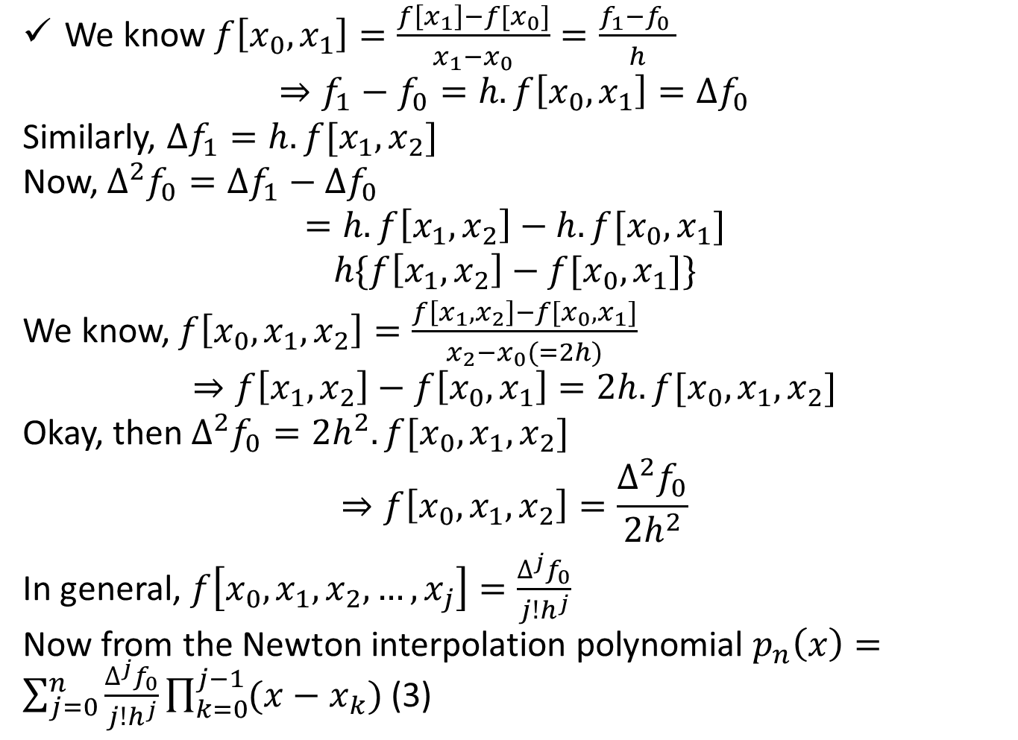
Interpolation with Equidistant Points
We know $f\left[x_{0},x_{1}\right]=\frac{f\left[x_{1}\right]−f[x_{0}]}{x_{1}−x_{0}}=\frac{f_{1}−f_{0} }{h}$
$$⇒f_{1}−f_{0}=h.f\left[x_{0},x_{1}\right]=∆f_{0}$$
Similarly, $∆f_{1}=h.f[x_{1},x_{2}]$
Now, $∆^{2}f_{0}=∆f_{1}−∆f_{0}$
$$=h.f\left[x_{1},x_{2}\right]−h.f[x_{0},x_{1}]$$
$$h\{f\left[x_{1},x_{2}\right]−f[x_{0},x_{1}]\}$$
We know, $f\left[x_{0},x_{1},x_{2}\right]=\frac{f\left[x_{1},x_{2}\right]−f[x_{0},x_{1}]}{x_{2}−x_{0}(=2h)}$
$$⇒f\left[x_{1},x_{2}\right]−f\left[x_{0},x_{1}\right]=2h.f[x_{0},x_{1},x_{2}]$$
Okay, then $∆^{2}f_{0}=2h^{2}.f[x_{0},x_{1},x_{2}]$
$$⇒f\left[x_{0},x_{1},x_{2}\right]=\frac{∆^{2}f_{0}}{2h^{2}}$$
In general, $f\left[x_{0},x_{1},x_{2},…,x_{j}\right]=\frac{∆^{j}f_{0}}{j!h^{j}}$
Now from the Newton interpolation polynomial $p_{n}\left(x\right)=\sum_{j=0}^{n}{\frac{∆^{j}f_{0}}{j!h^{j}}\prod_{k=0}^{j−1}{(x−x_{k})}}$ (3)
Newton
Backward

Slide 14
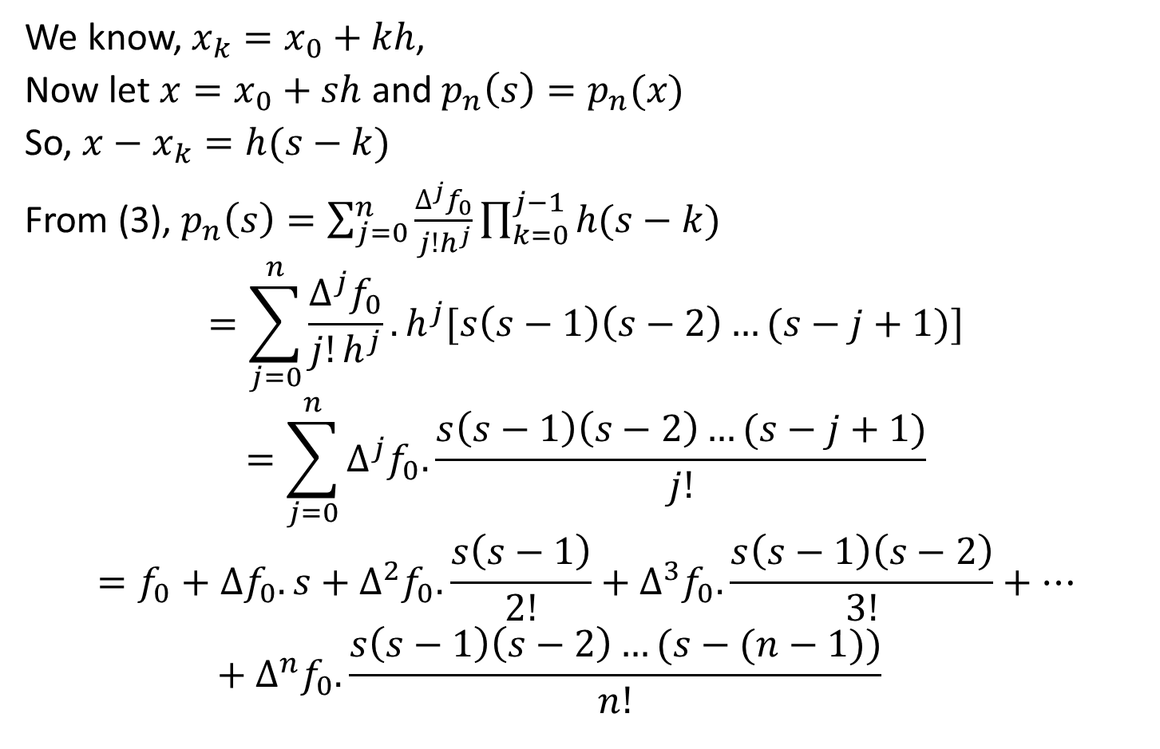
Interpolation with Equidistant Points
We know, $x_{k}=x_{0}+kh$,
Now let $x=x_{0}+sh$ and $p_{n}\left(s\right)=p_{n}(x)$
So, $x−x_{k}=h(s−k)$
From (3), $p_{n}\left(s\right)=\sum_{j=0}^{n}{\frac{∆^{j}f_{0}}{j!h^{j}}\prod_{k=0}^{j−1}{h(s−k)}}$
$$=\sum_{j=0}^{n}{\frac{∆^{j}f_{0}}{j!h^{j}}.h^{j}[s\left(s−1\right)\left(s−2\right)…(s−j+1)]}$$
$$=\sum_{j=0}^{n}{∆^{j}f_{0}.\frac{s\left(s−1\right)\left(s−2\right)…(s−j+1)}{j!}}$$
$$=f_{0}+∆f_{0}.s+∆^{2}f_{0}.\frac{s\left(s−1\right)}{2!}+∆^{3}f_{0}. \frac{s\left(s−1\right)\left(s−2\right)}{3!}+…+∆^{n}f_{0}.\frac{s\left(s−1\right)\left(s−2\right)…(s−(n−1))}{n!}$$
This formula is called Newton-Gregory forward difference formula

Slide 15
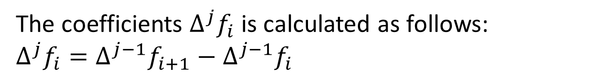
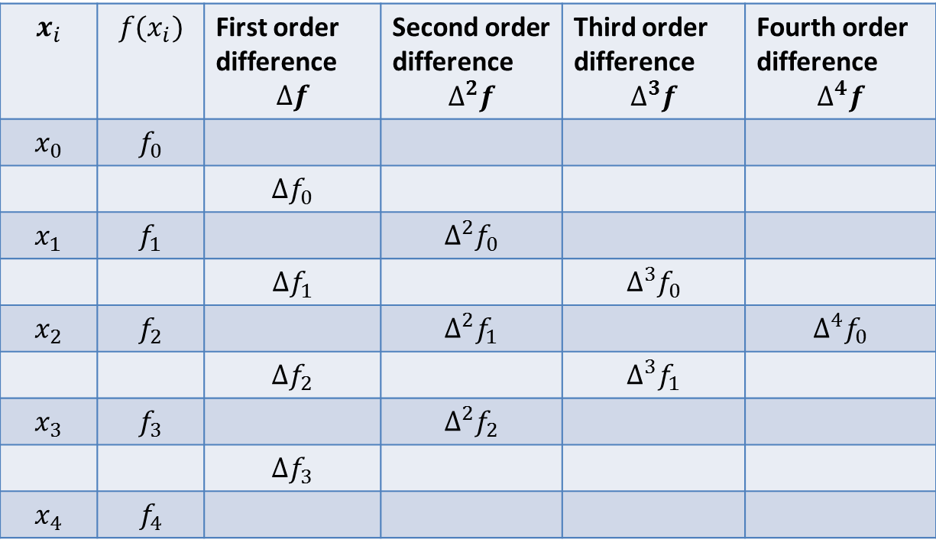
Interpolation with Equidistant Points
The coefficients $∆^{j}f_{i}$ is calculated as follows: $∆^{j}f_{i}=∆^{j−1}f_{i+1}−∆^{j−1}f_{i}$
$$x_{i}$$ | $$f(x_{i})$$ | First order difference $$∆f$$ | Second order difference $$∆^{2}f$$ | Third order difference $$∆^{3}f$$ | Fourth order difference $$∆^{4}f$$
$$x_{0}$$ | $$f_{0}$$
 |  | $$∆f_{0}$$
$$x_{1}$$ | $$f_{1}$$ |  | $$∆^{2}f_{0}$$
 |  | $$∆f_{1}$$ |  | $$∆^{3}f_{0}$$
$$x_{2}$$ | $$f_{2}$$ |  | $$∆^{2}f_{1}$$ |  | $$∆^{4}f_{0}$$
 |  | $$∆f_{2}$$ |  | $$∆^{3}f_{1}$$
$$x_{3}$$ | $$f_{3}$$ |  | $$∆^{2}f_{2}$$
 |  | $$∆f_{3}$$
$$x_{4}$$ | $$f_{4}$$
These are the differences we need
Forward difference table

Slide 16
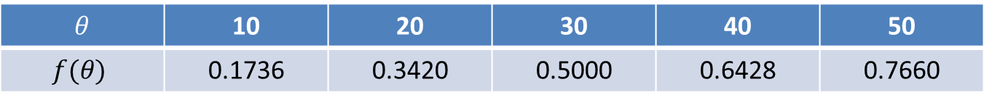
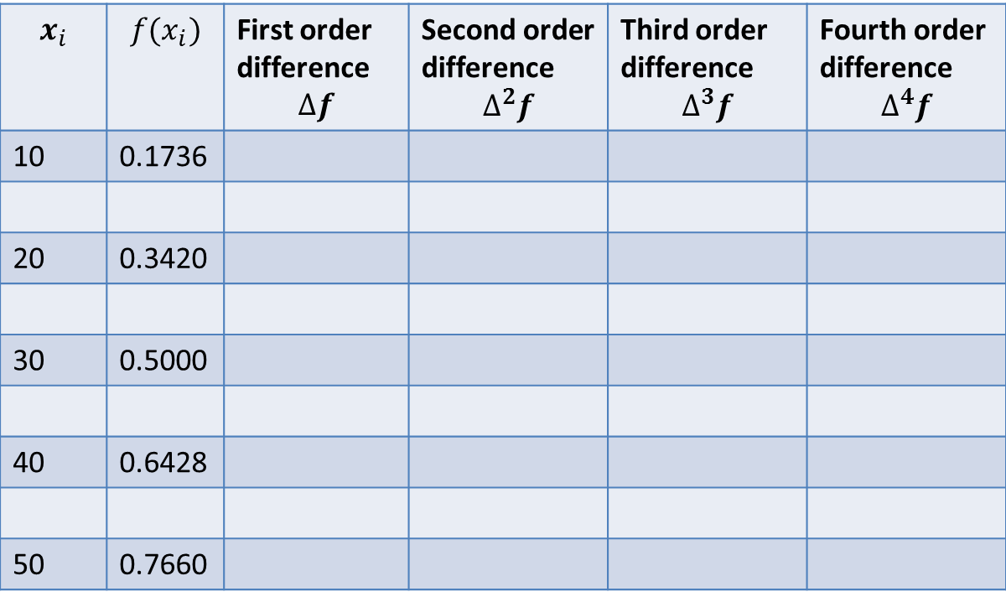

Interpolation with Equidistant Points
Estimate the value of $f(θ)$for θ$={35}^{°}$ using Newton-Gregory forward difference formula
$θ$ | 10 | 20 | 30 | 40 | 50
$$f(θ)$$ | 0.1736 | 0.3420 | 0.5000 | 0.6428 | 0.7660
$$x_{i}$$ | $$f(x_{i})$$ | First order difference $$∆f$$ | Second order difference $$∆^{2}f$$ | Third order difference $$∆^{3}f$$ | Fourth order difference $$∆^{4}f$$
10 | 0.1736
20 | 0.3420
30 | 0.5000
40 | 0.6428
50 | 0.7660
0.1684
-0.0104
0.1580
-0.0048
-0.0152
0.0004
0.1428
-0.0044
-0.0196
0.1232

Slide 17
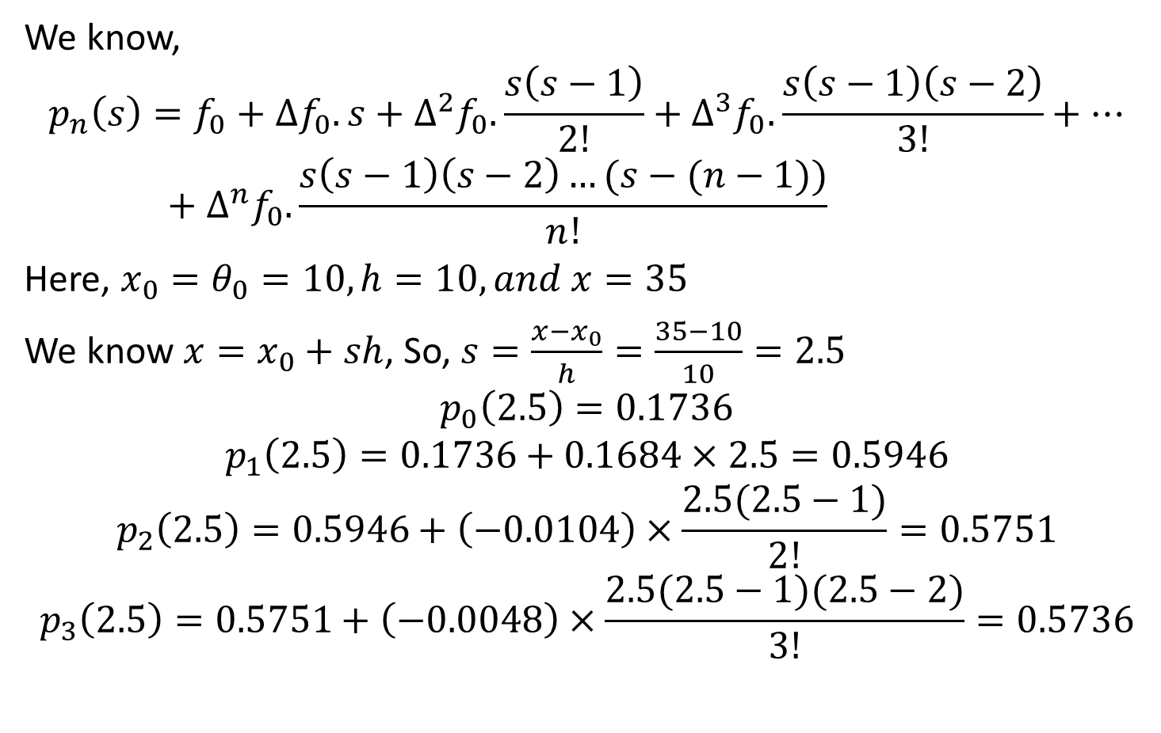
Forward Difference Table
We know,
$${p_{n}\left(s\right)=f}_{0}+∆f_{0}.s+∆^{2}f_{0}.\frac{s\left(s−1\right)}{2!}+∆^{3}f_{0}. \frac{s\left(s−1\right)\left(s−2\right)}{3!}+…+∆^{n}f_{0}.\frac{s\left(s−1\right)\left(s−2\right)…(s−(n−1))}{n!}$$
Here, $x_{0}=θ_{0}=10, h=10, and x=35$
We know $x=x_{0}+sh$, So, $s=\frac{x−x_{0}}{h}=\frac{35−10}{10}=2.5$
$$p_{0}\left(2.5\right)=0.1736$$
$$p_{1}\left(2.5\right)=0.1736+0.1684×2.5=0.5946$$
$$p_{2}\left(2.5\right)=0.5946+\left(−0.0104\right)×\frac{2.5(2.5−1)}{2!}=0.5751$$
$$p_{3}\left(2.5\right)=0.5751+\left(−0.0048\right)×\frac{2.5(2.5−1)(2.5−2)}{3!}=0.5736$$
You can see that after 3rd order the result is accurate to three decimal places

Slide 18
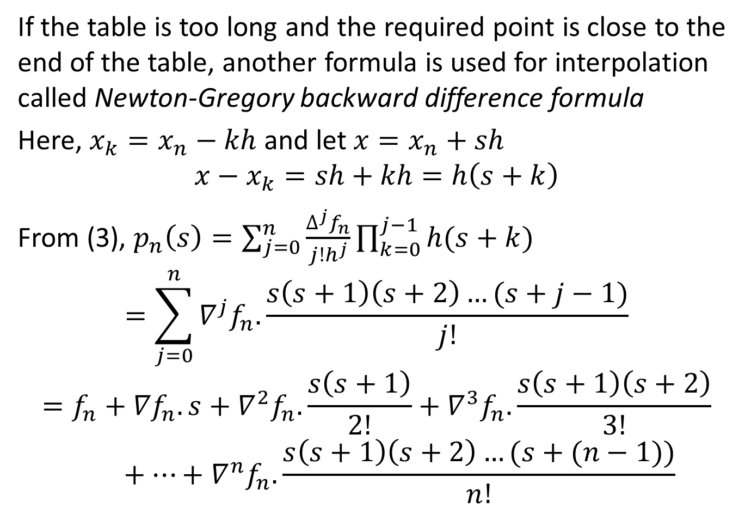
Backward Difference Table
If the table is too long and the required point is close to the end of the table, another formula is used for interpolation called Newton-Gregory backward difference formula
Here, $x_{k}=x_{n}−kh$ and let $x=x_{n}+sh$
$$x−x_{k}=sh+kh=h\left(s+k\right)$$
From (3), $p_{n}\left(s\right)=\sum_{j=0}^{n}{\frac{∆^{j}f_{n}}{j!h^{j}}\prod_{k=0}^{j−1}{h(s+k)}}$
$$=\sum_{j=0}^{n}{∇^{j}f_{n}.\frac{s\left(s+1\right)\left(s+2\right)…(s+j−1)}{j!}}$$
$$=f_{n}+{∇f}_{n}.s+∇^{2}f_{n}.\frac{s\left(s+1\right)}{2!}+∇^{3}f_{n}. \frac{s\left(s+1\right)\left(s+2\right)}{3!}+…+∇^{n}f_{n}.\frac{s\left(s+1\right)\left(s+2\right)…(s+(n−1))}{n!}$$
to eq. (3)

Slide 19
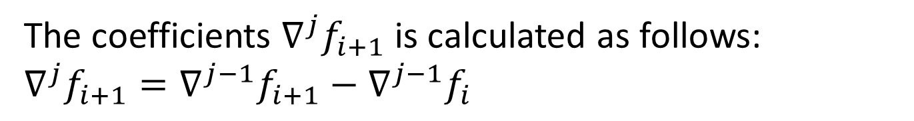
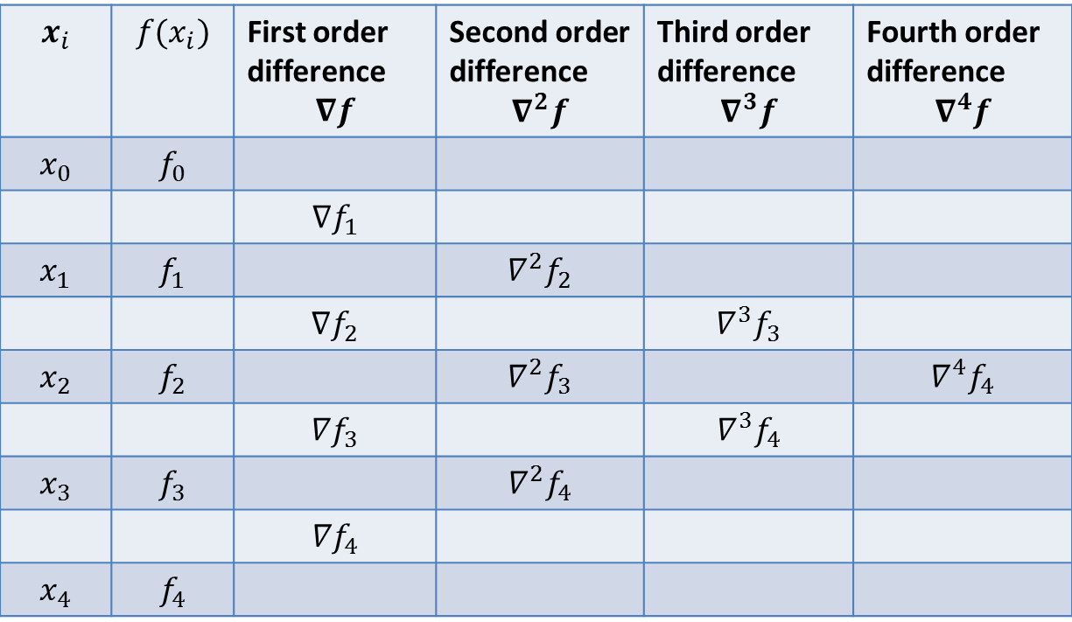
Backward Difference Table
The coefficients $∇^{j}f_{i+1}$ is calculated as follows: $∇^{j}f_{i+1}=∇^{j−1}f_{i+1}−∇^{j−1}f_{i}$
$$x_{i}$$ | $$f(x_{i})$$ | First order difference $$∇f$$ | Second order difference $$∇^{2}f$$ | Third order difference $$∇^{3}f$$ | Fourth order difference $$∇^{4}f$$
$$x_{0}$$ | $$f_{0}$$
 |  | $$∇f_{1}$$
$$x_{1}$$ | $$f_{1}$$ |  | $$∇^{2}f_{2}$$
 |  | $${∇f}_{2}$$ |  | $$∇^{3}f_{3}$$
$$x_{2}$$ | $$f_{2}$$ |  | $$∇^{2}f_{3}$$ |  | $$∇^{4}f_{4}$$
 |  | $${∇f}_{3}$$ |  | $$∇^{3}f_{4}$$
$$x_{3}$$ | $$f_{3}$$ |  | $$∇^{2}f_{4}$$
 |  | $${∇f}_{4}$$
$$x_{4}$$ | $$f_{4}$$
However, the calculation is same of forward difference table
These are the differences we need
Backward difference table

Slide 20
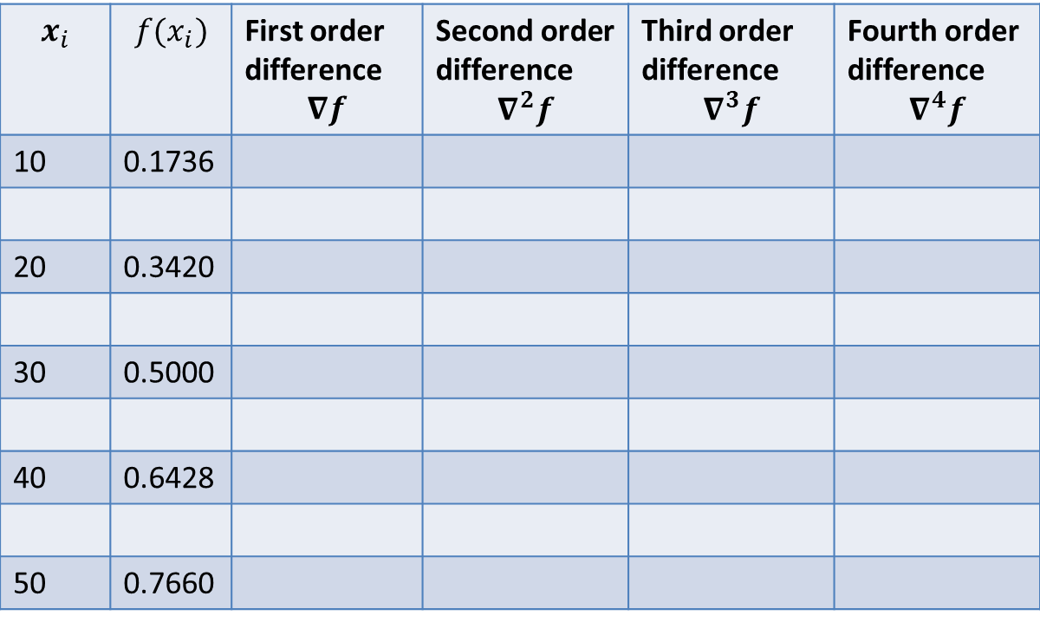

Backward Difference Table
Estimate the value of $f(θ)$for θ$={35}^{°}$ using Newton-Gregory backward difference formula
$θ$ | 10 | 20 | 30 | 40 | 50
$$f(θ)$$ | 0.1736 | 0.3420 | 0.5000 | 0.6428 | 0.7660
$$x_{i}$$ | $$f(x_{i})$$ | First order difference $$∇f$$ | Second order difference $$∇^{2}f$$ | Third order difference $$∇^{3}f$$ | Fourth order difference $$∇^{4}f$$
10 | 0.1736
20 | 0.3420
30 | 0.5000
40 | 0.6428
50 | 0.7660
0.1684
-0.0104
0.1580
-0.0048
-0.0152
0.0004
0.1428
-0.0044
-0.0196
0.1232

Slide 21
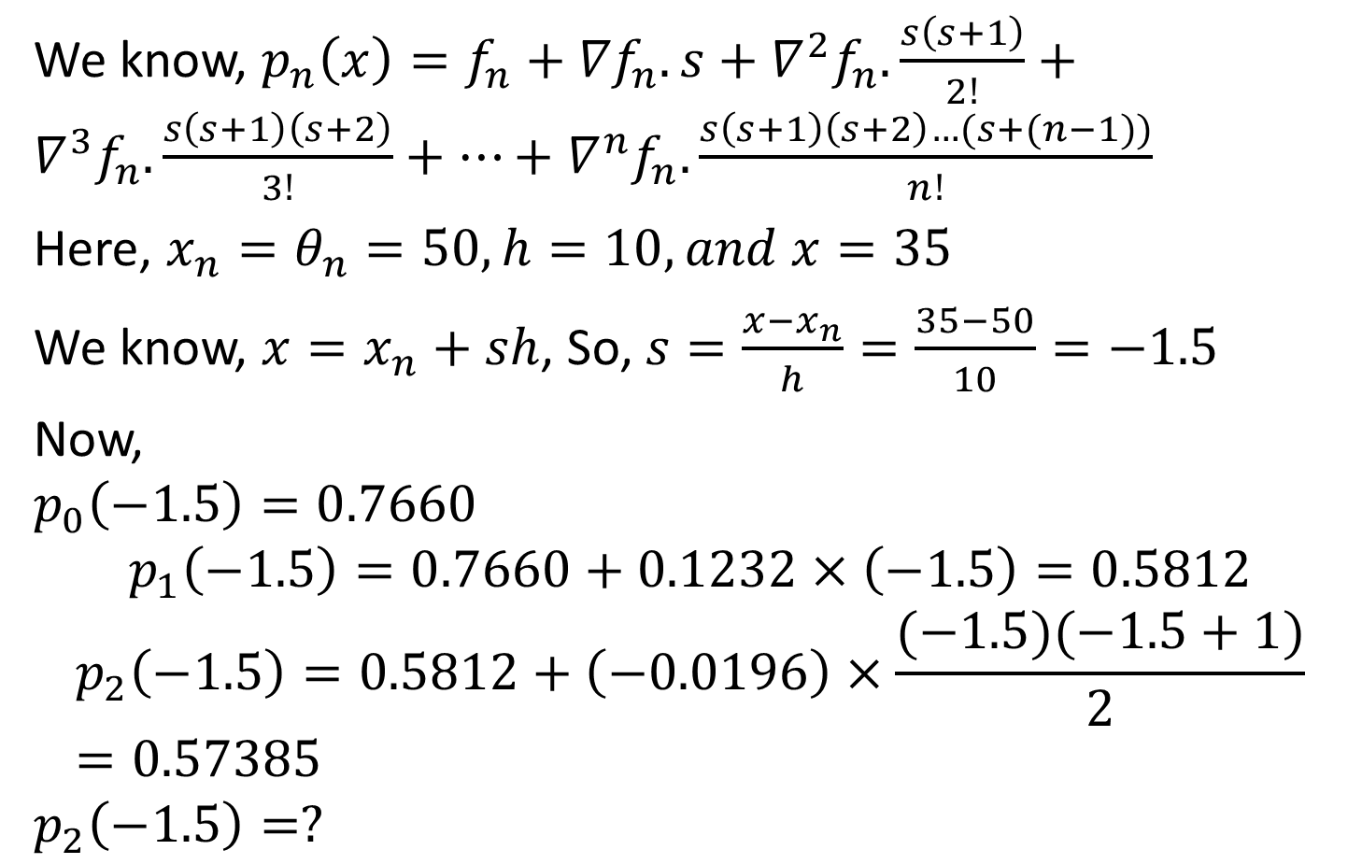
Backward Difference Table
We know, ${p_{n}\left(x\right)=f}_{n}+{∇f}_{n}.s+∇^{2}f_{n}.\frac{s\left(s+1\right)}{2!}+∇^{3}f_{n}. \frac{s\left(s+1\right)\left(s+2\right)}{3!}+…+∇^{n}f_{n}.\frac{s\left(s+1\right)\left(s+2\right)…(s+(n−1))}{n!}$
Here, $x_{n}=θ_{n}=50, h=10, and x=35$
We know, $x=x_{n}+sh$, So, $s=\frac{x−x_{n}}{h}=\frac{35−50}{10}=−1.5$
Now,
$$p_{0}\left(−1.5\right)=0.7660$$
$$p_{1}\left(−1.5\right)=0.7660+0.1232×\left(−1.5\right)=0.5812$$
$$p_{2}\left(−1.5\right)=0.5812+\left(−0.0196\right)×\frac{(−1.5)(−1.5+1)}{2}=0.57385$$
$$p_{2}\left(−1.5\right)=?$$

Slide 22
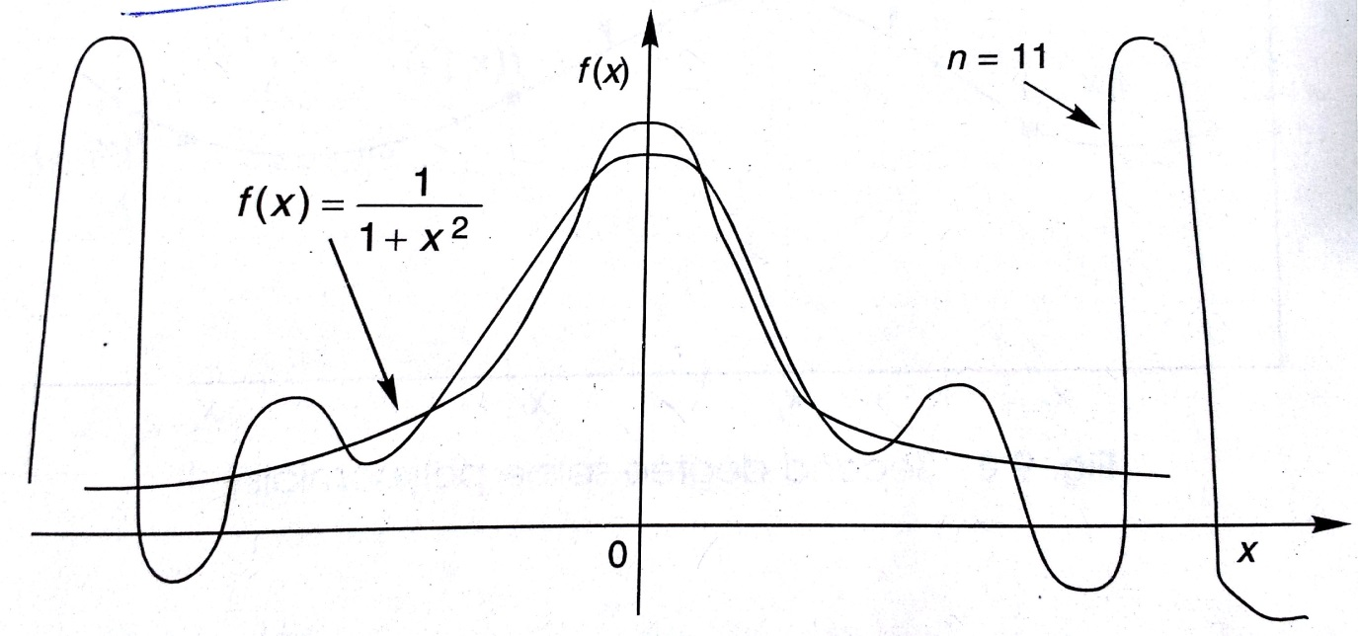
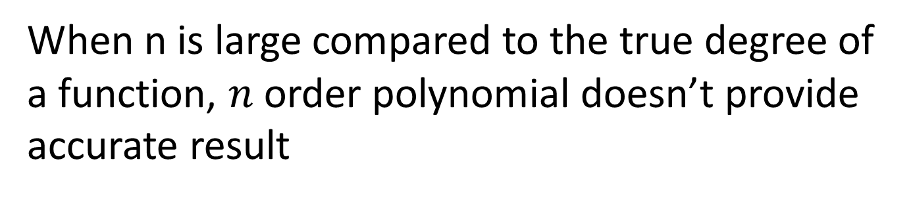
Spline Interpolation
When n is large compared to the true degree of a function, $n$ order polynomial doesn’t provide accurate result
Undesirable maxima
Actual function
Undesirable minima

Slide 23
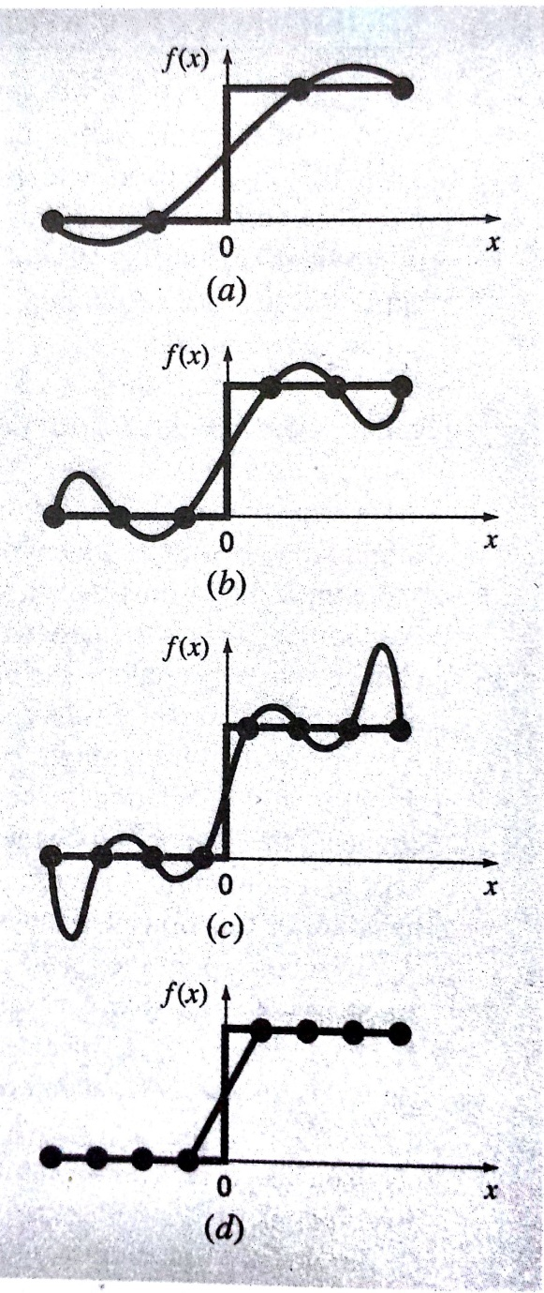
Spline Interpolation
More examples
Increasing polynomial order provides wilder oscillations
Rather spline interpolation (max. 3rd order ) gives better result

Slide 24




Spline Interpolation
The solution is,
Divide the entire range of points into subintervals and use local low-order polynomials to interpolate each interval
Piecewise polynomials
f(x)
Actual functions
Knots
$$x_{i−1}$$
$$x_{i}$$
x
$$x_{i+2}$$
$$x_{i+1}$$

Slide 25
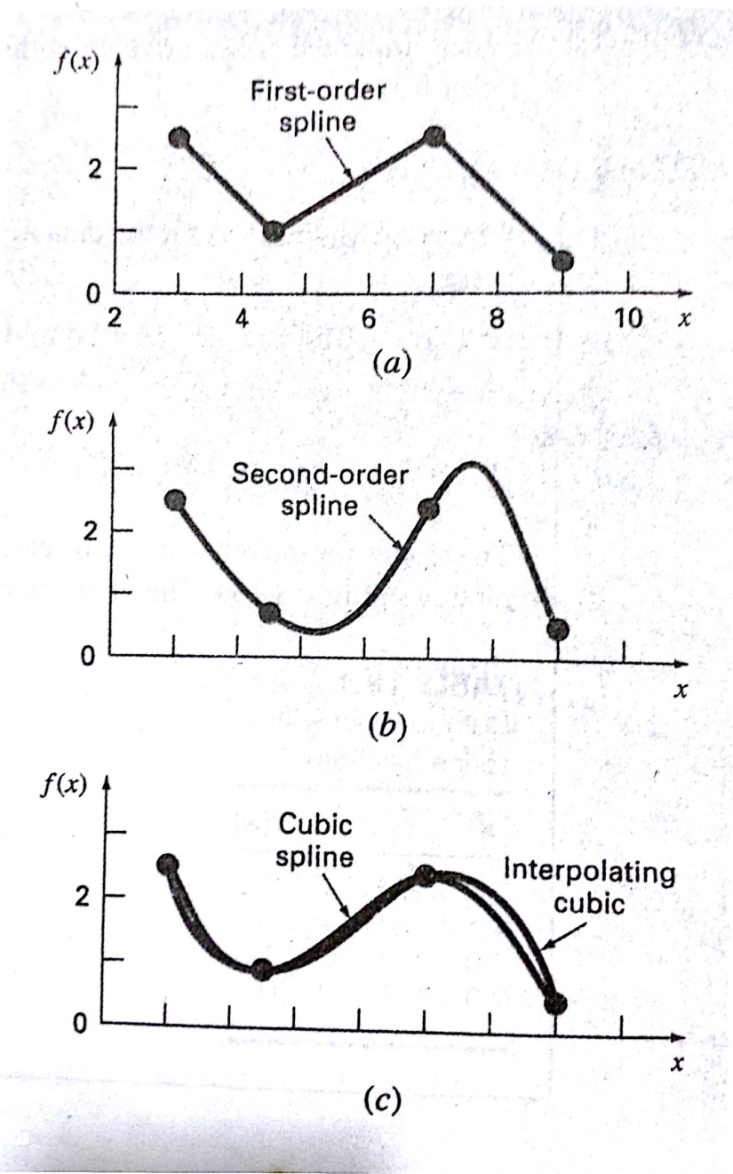
Spline Interpolation
Different orders of spline
Higher order spline removes discontinuity and provides smooth interpolation

Slide 26
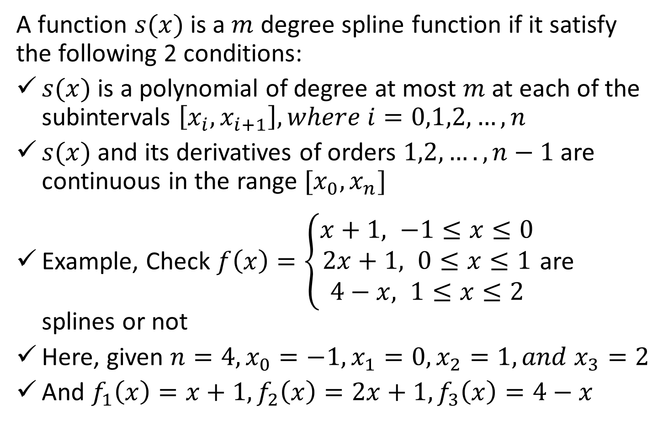
Spline Interpolation
A function $s(x)$ is a $m$ degree spline function if it satisfy the following 2 conditions:
$s(x)$ is a polynomial of degree at most $m$ at each of the subintervals $\left[x_{i},x_{i+1}\right], where i=0,1,2,…,n$
$s(x)$ and its derivatives of orders $1,2,….,n−1$ are continuous in the range $[x_{0},x_{n}]$
Example, Check $f\left(x\right)=\left\{\begin{aligned}x+1, −1≤x≤0 \\ 2x+1, 0≤x≤1 \\ 4−x, 1≤x≤2\end{aligned}\right.$ are splines or not
Here, given $n=4, x_{0}=−1,x_{1}=0,x_{2}=1, and x_{3}=2$
And $f_{1}\left(x\right)=x+1, f_{2}\left(x\right)=2x+1, f_{3}\left(x\right)=4−x$

Slide 27
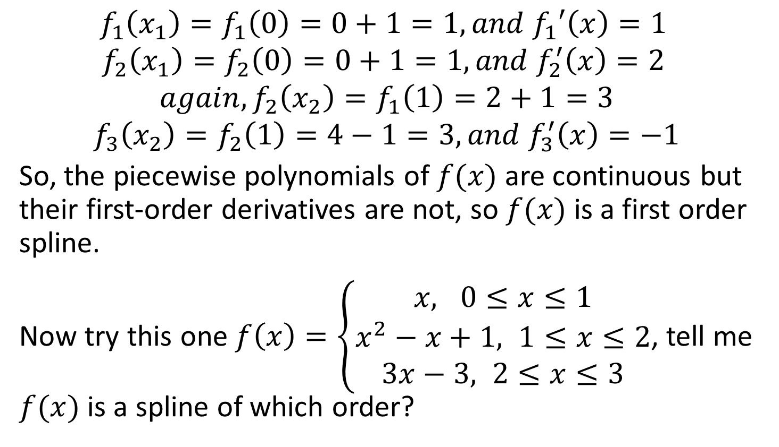
Spline Interpolation
$$f_{1}\left(x_{1}\right)=f_{1}\left(0\right)=0+1=1, and f_{1}′\left(x\right)=1$$
$$f_{2}\left(x_{1}\right)=f_{2}\left(0\right)=0+1=1, and f_{2}^{′}\left(x\right)=2$$
$$again, f_{2}\left(x_{2}\right)=f_{1}\left(1\right)=2+1=3$$
$$f_{3}\left(x_{2}\right)=f_{2}\left(1\right)=4−1=3, and f_{3}^{′}\left(x\right)=−1$$
So, the piecewise polynomials of $f(x)$ are continuous but their first-order derivatives are not, so $f(x)$ is a first order spline.
Now try this one $f\left(x\right)=\left\{\begin{aligned}x, 0≤x≤1 \\ x^{2}−x+1, 1≤x≤2 \\ 3x−3, 2≤x≤3\end{aligned}\right.$, tell me $f(x)$is a spline of which order?

Slide 28
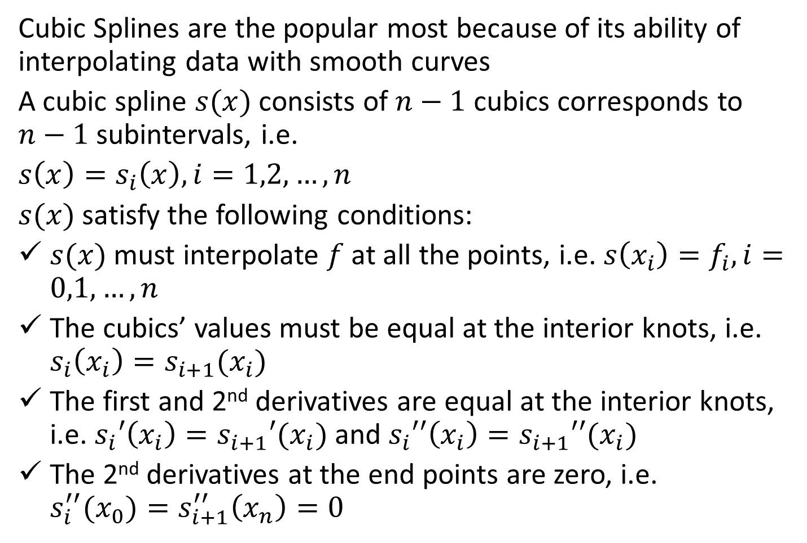
Cubic Splines
Cubic Splines are the popular most because of its ability of interpolating data with smooth curves
A cubic spline $s(x)$ consists of $n−1$ cubics corresponds to $n−1$ subintervals, i.e.
$s\left(x\right)=s_{i}\left(x\right), i=1,2,…,n$
$s(x)$satisfy the following conditions:
$s(x)$must interpolate $f$ at all the points, i.e. $s\left(x_{i}\right)=f_{i}, i=0,1,…,n$
The cubics’ values must be equal at the interior knots, i.e. $s_{i}\left(x_{i}\right)=s_{i+1}(x_{i})$
The first and 2nd derivatives are equal at the interior knots, i.e. $s_{i}′\left(x_{i}\right)=s_{i+1}′(x_{i})$ and $s_{i}′′\left(x_{i}\right)=s_{i+1}′′(x_{i})$
The 2nd derivatives at the end points are zero, i.e. $s_{i}^{′′}(x_{0})=s_{i+1}^{′′}\left(x_{n}\right)=0$

Slide 29
References
1. Numerical Methods by E Balagurusamy
2. Numerical Methods for Engineers by S.C. Chapra, R.P. Canale

